Slide 1
IBM Data Science Professional Certificate Capstone Project The Battle of Neighborhoods
Damien Azzopardi – July 2021

Slide 2

Introduction
The Green Alternative is a group of vegetarian restaurants, which started operating in Madrid, Spain, in 2010. We are currently running six different restaurants across different neighborhoods in Madrid, oriented towards locals. As our group is becoming successful in the Spanish capital, this year, we would like to expand our operations and open a vegetarian restaurant in Barcelona.
What is the best neighborhood to open a vegetarian restaurant in Barcelona?

Slide 3
Introduction
After running a market research and looking into the data collected from our six current restaurants in Madrid, we found that our most successful locations are in neighborhoods which, in order of priority:
1. Are close to a metro or train station, where the flow of people is high.
2. Have a gym close by, as most of our customers come for lunch or dinner after training at the gym.
3. Have a park or garden close by, where our customers like to have lunch.
What neighborhood in Barcelona meets these criterion, in this order?

Slide 4
Data
The data we will be using to help us answer our question comes from the following sources.
Neighborhoods
& Coordinates
Metabolism of Cities
Method: web scrapping
Districts
Wikipedia
Method: csv import
Venues
Foursquare
Method: location API

Slide 5
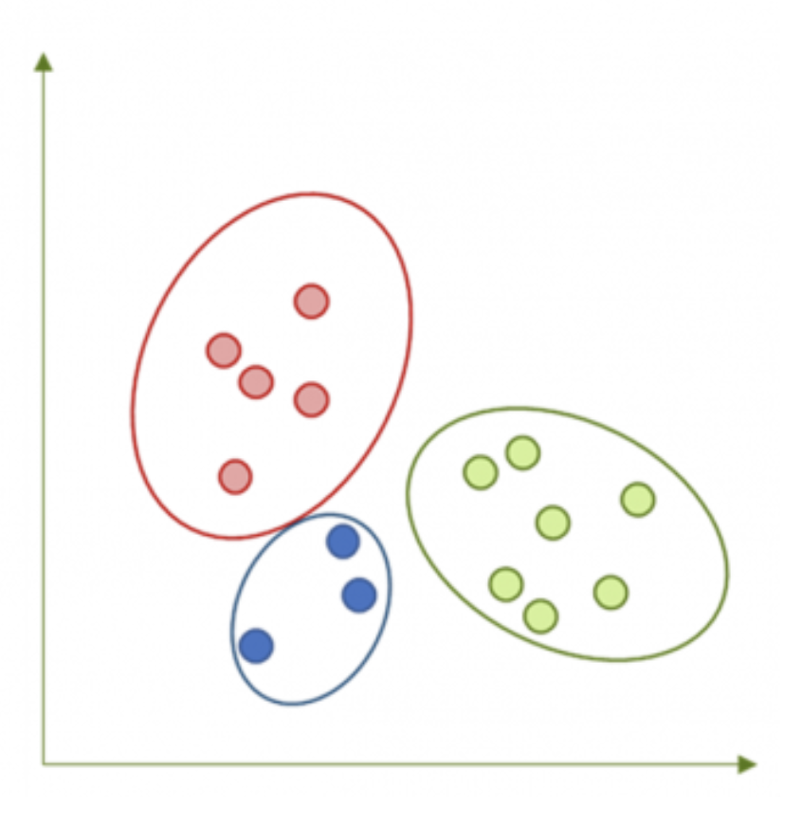
Methodology
For this analysis, we’ll go for a classification approach using the K Means method. We will classify all neighborhoods in Barcelona into five different clusters, considering only the venues that match our criterion - Metro Station, Train Station, Park, Garden, Gym – and look for the clusters that are in line with the data we’ve collected from our six current restaurants in Madrid.

Slide 6
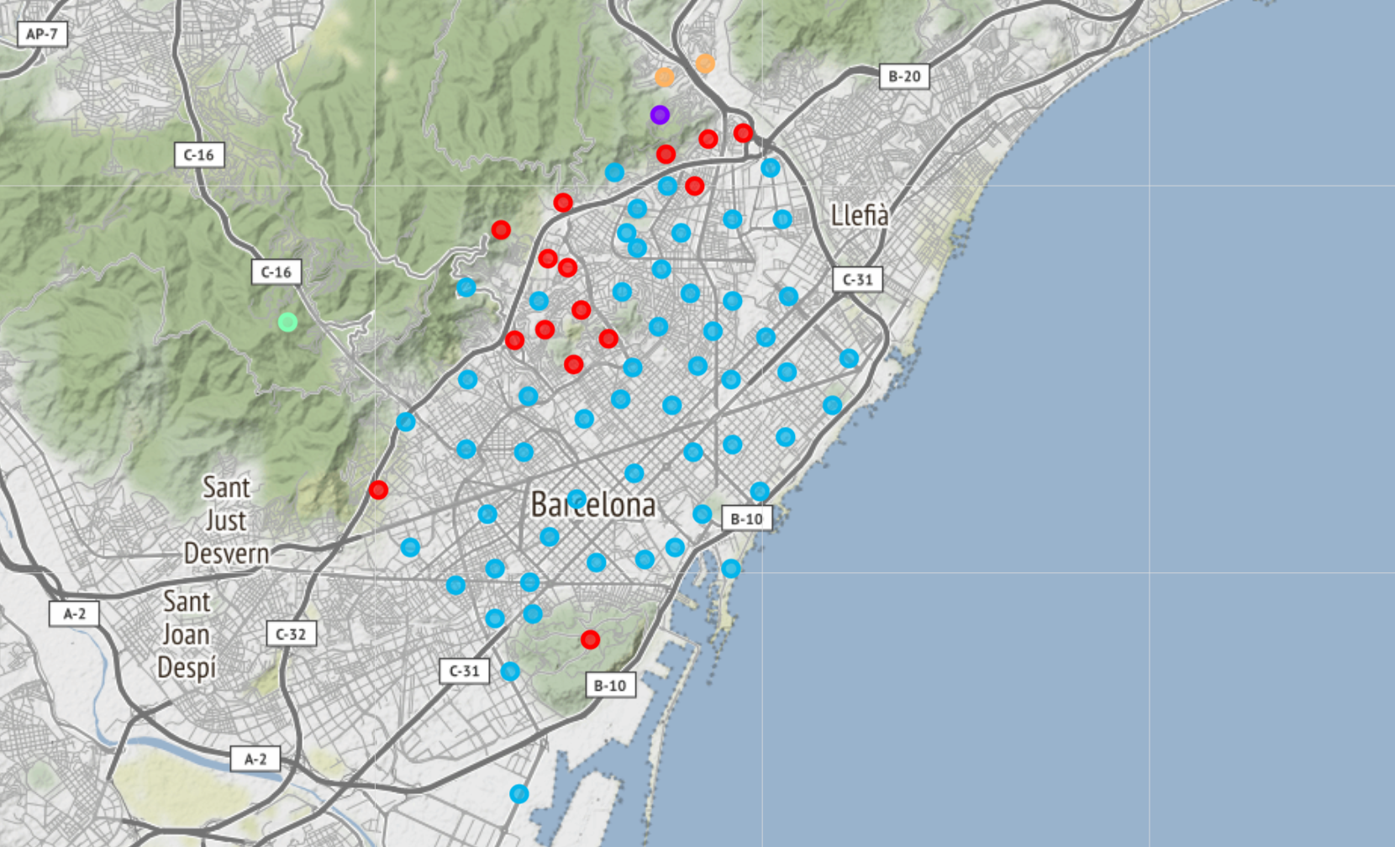
Results
Using the K Means method to classify all neighborhoods in Barcelona, we ended up with these five clusters.
Diving into each of these clusters, we found that one exactly matches our original criterion (cluster #2, purple point on the map), whose first most common venue is a Metro or Train Station, the second most common venue is a Gym, and the third most common venue is a Park or a Garden.

Slide 7
Conclusion
Based on the data previously collected in the city of Madrid and the analysis ran on Barcelona's neighborhoods, we can safely say that the Torre Barró neighborhood is the best area to open a new franchise of our Green Alternative restaurants.
It is important to mention that this neighborhood is quite far from the city center, where most of the touristic attractions are. This should not be a problem for the Green Alternative as its current restaurants are oriented towards locals, and the group wants to keep this same direction. However, if the group decides to switch its focus in the future and expand its customer base to a broader audience, they will need to replicate this analysis taking into accounts new criterion, different from the ones picked for this analysis.

